Slide 1
CA LAB 6

Slide 2
Till Now you can
Interface switch
Interface & control LED
Use digital Pins
Use Analog Sensor
Use Serial Monitor
Interface LCD 16x2
Temperature Sensor

Slide 3
Question?
What parameters you will use to describe some object or anything (Remember use quantities)

Slide 4
Parameters
Location (co-ordinates)
State (static or moving )
Speed
Distance
Dimensions

Slide 5
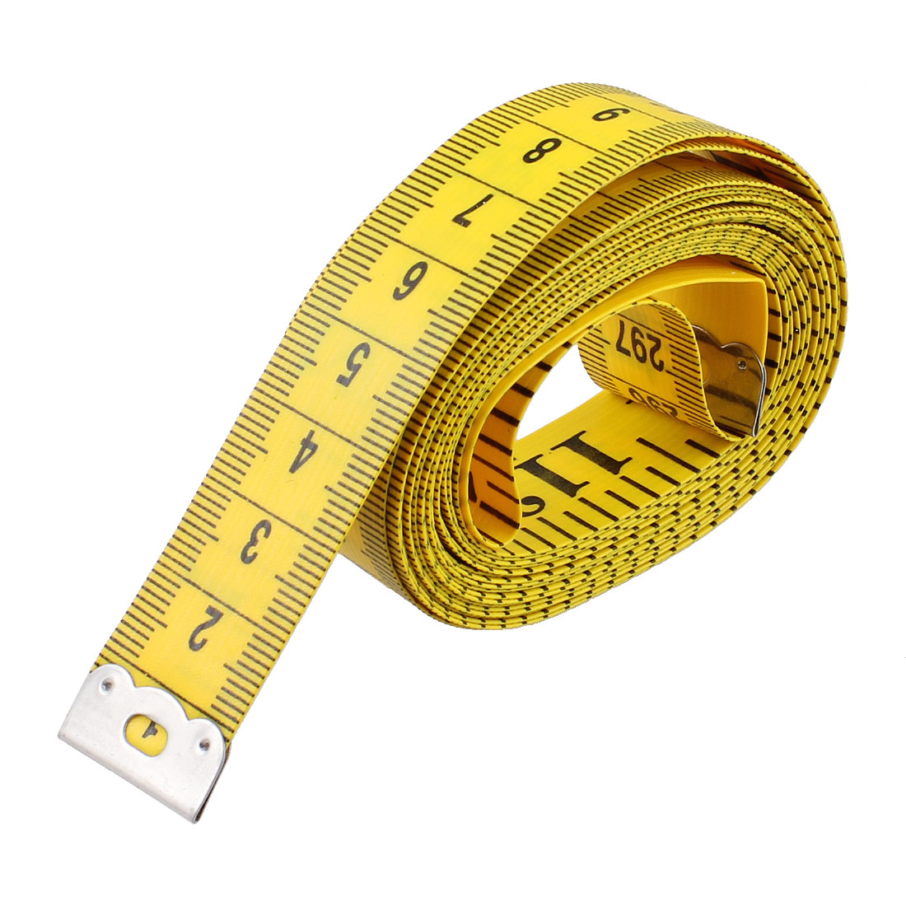
Distance

Slide 6
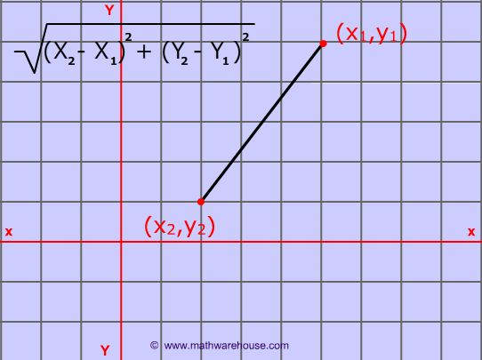
Distance

Slide 7
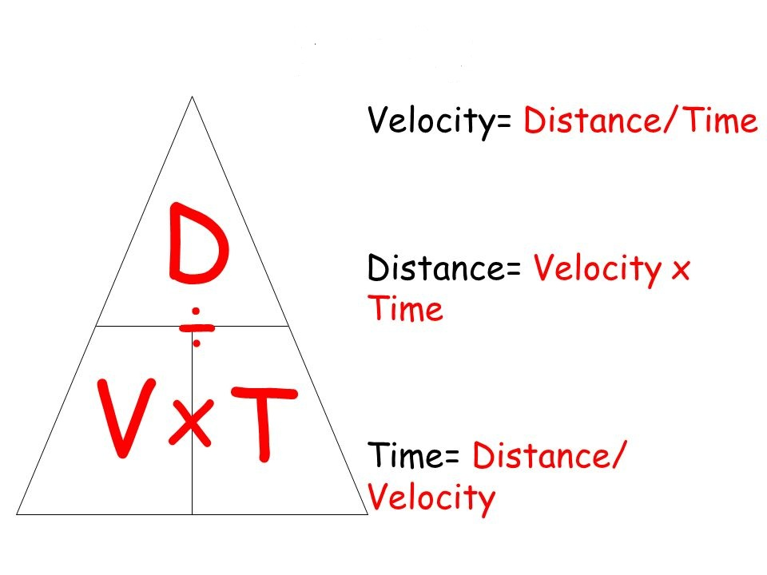
Distance

Slide 8
Waves
Wave, propagation of disturbances from place to place in a regular and organized way.
E.g: Sound waves, Water tides, Electromagentic waves.
Waves are classified into two types
Transverse waves
Longitudinal waves

Slide 9
Parameters & Properties of Wave
Frequency
Amplitude
Wavelength
Velocity

Slide 10
Parameters & Properties of Wave
Reflection
Refraction
Diffraction
Interference
Doppler effect

Slide 11
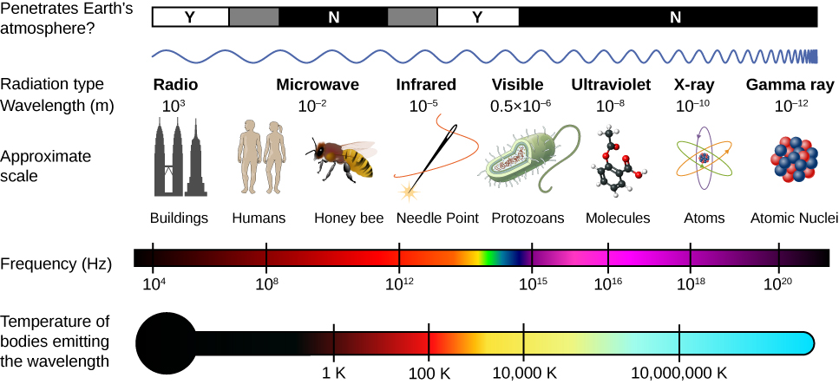
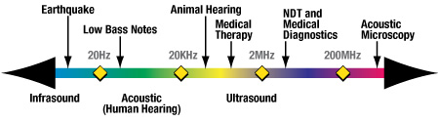

Slide 12
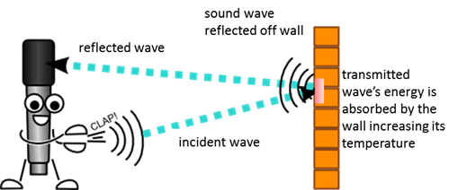
Reflection Of Wave

Slide 13
Distance & Position Measuring Sensors

Slide 14
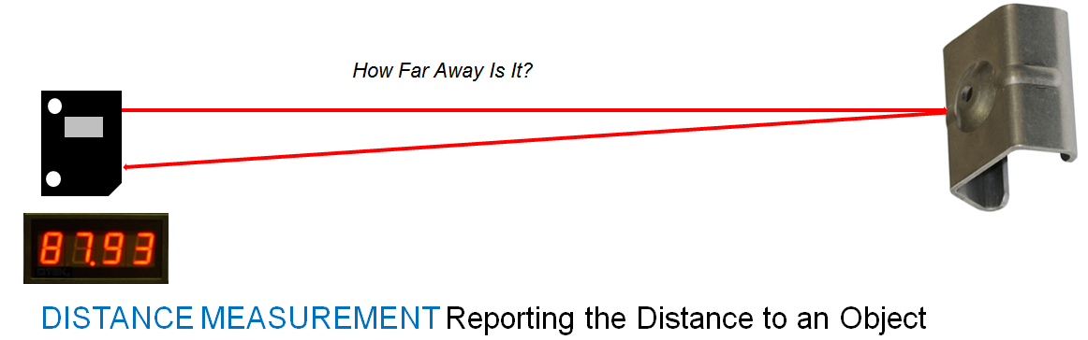
Laser Sensor

Slide 15
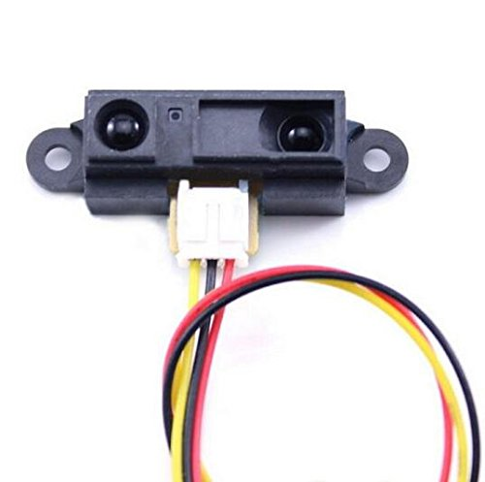
IR Sensor

Slide 16
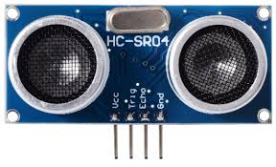
Ultra Sonic Sensor

Slide 17
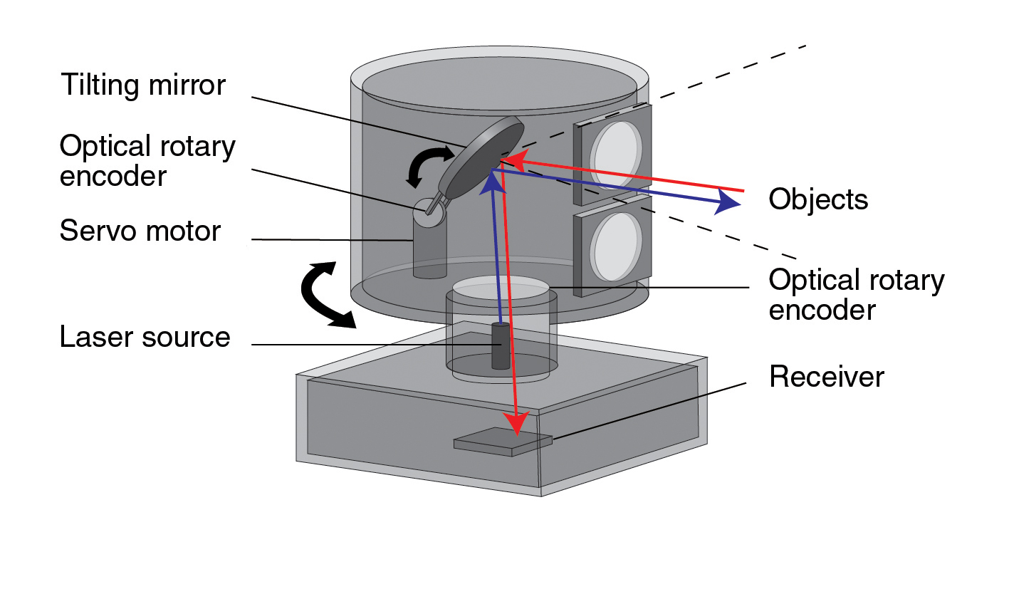
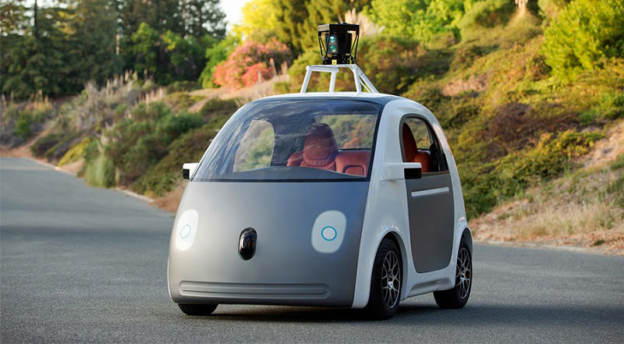
LIDAR

Slide 18
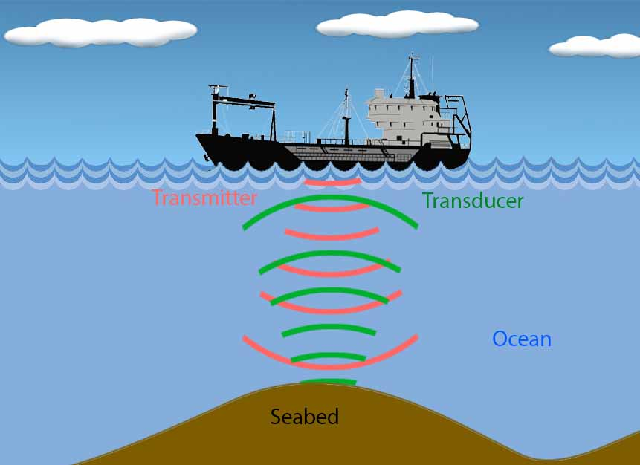
Sonar

Slide 19
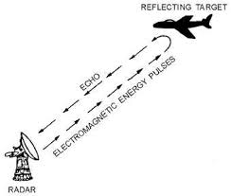
RADAR

Slide 20
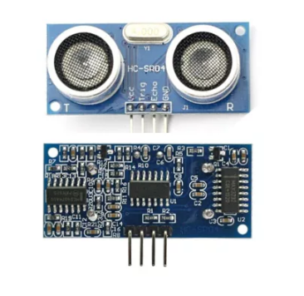
HC-SR04

Slide 21
Features
Power Supply :+5V DC
Quiescent Current : <2mA
Working Current: 15mA
Effectual Angle: <15°
Ranging Distance : 2cm – 400 cm/1″ – 13ft
Resolution : 0.3 cm
Measuring Angle: 30 degree
Trigger Input Pulse width: 10uS
Dimension: 45mm x 20mm x 15mm

Slide 22
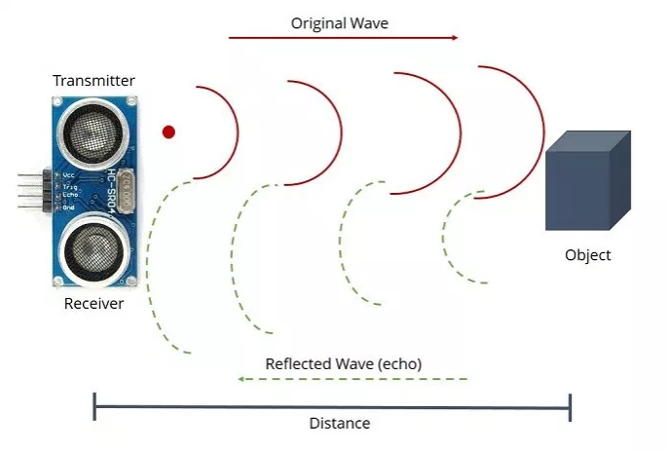
Working
1)The transmitter (trig pin) sends a signal: a high-frequency sound.
2) When the signal finds an object, it is reflected and the transmitter (echo pin) receives it.
3) The time between the transmission and reception of the signal allows us to calculate the distance to an object

Slide 23
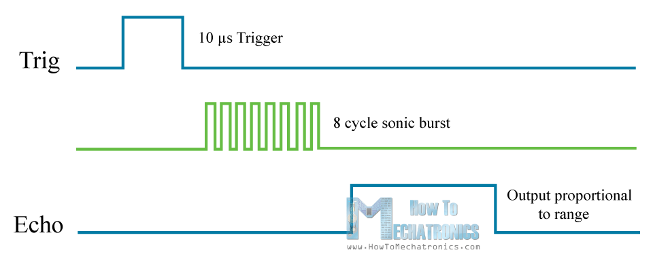
Working

Slide 24
Formula
distance = (traveltime/2) x speed of sound

Slide 25
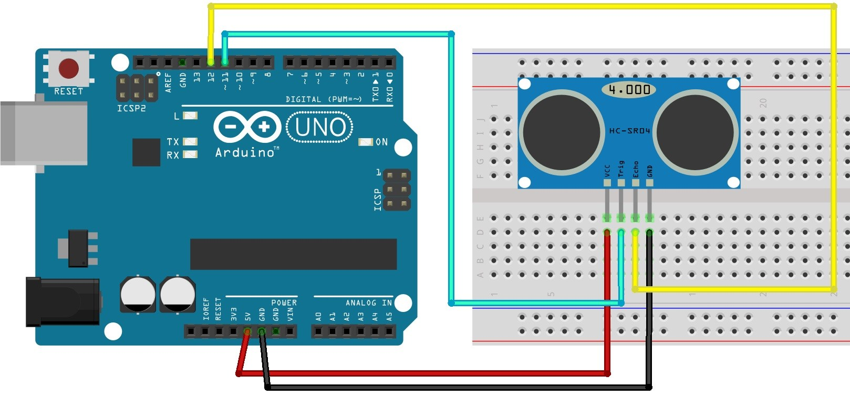

Slide 26
Code
// defines pins numbers
const int trigPin = 11;
const int echoPin = 8;
// defines variables
long duration;
int distance;
void setup() {
pinMode(trigPin, OUTPUT); // Sets the trigPin as an Output
pinMode(echoPin, INPUT); // Sets the echoPin as an Input
Serial.begin(9600); // Starts the serial communication
}

Slide 27
Code
void loop() {
// Clears the trigPin
digitalWrite(trigPin, LOW);
delayMicroseconds(2);
// Sets the trigPin on HIGH state for 10 micro seconds
digitalWrite(trigPin, HIGH);
delayMicroseconds(10);
digitalWrite(trigPin, LOW);
// Reads the echoPin, returns the sound wave travel time in microseconds
duration = pulseIn(echoPin, HIGH);
// Calculating the distance
distance= duration*0.034/2;
// Prints the distance on the Serial Monitor
Serial.print("Distance: ");
Serial.println(distance);

Slide 28
pulseIn()
Reads a pulse (either HIGH or LOW) on a pin. For example, if value is HIGH, pulseIn() waits for the pin to go from LOW to HIGH, starts timing, then waits for the pin to go LOW and stops timing. Returns the length of the pulse in microseconds or gives up and returns 0 if no complete pulse was received within the timeout.

Slide 29
pulseIn()
Mim time= 10micro second
Max Time= 3minutes
Syntax
pulseIn(pin, value);
pulseIn(pin, value, timeout);

Slide 30
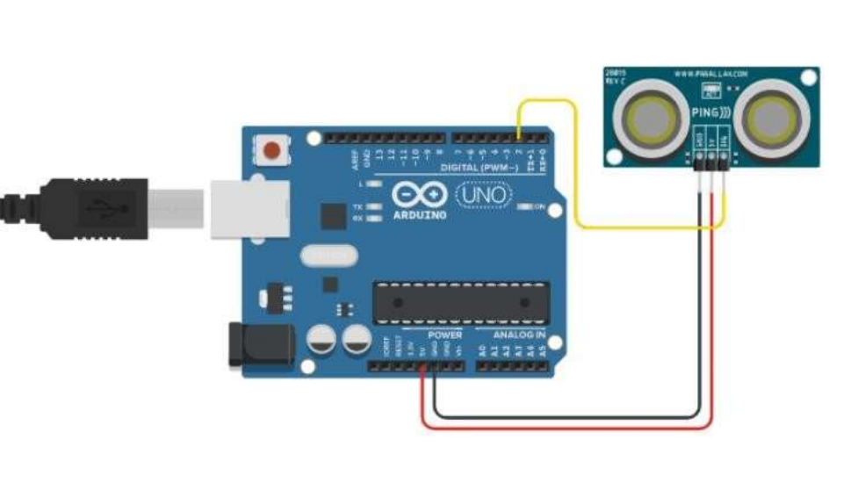
HC-SR03

Slide 31
HC-SR03
Same features and working like HC-SR04
It has 3 pins VCC,GND & Impulse
Impulse pin is used for sending the signal and as well as to receive echo.

